Slide 1

DragonEvents
Phase1- DEMO

Slide 2
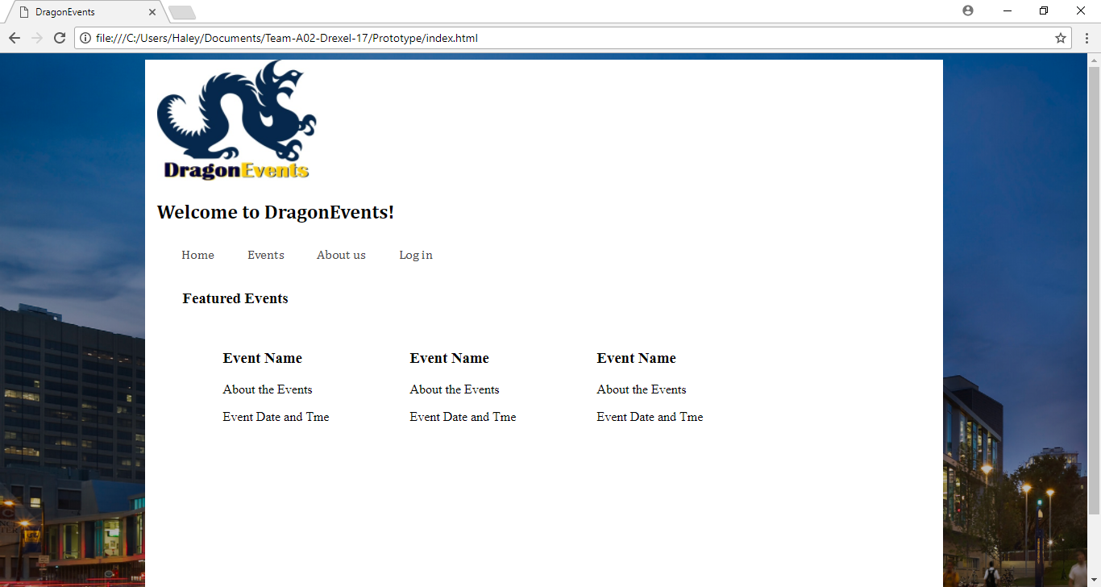
PROTOTYPE
HOME

Slide 3
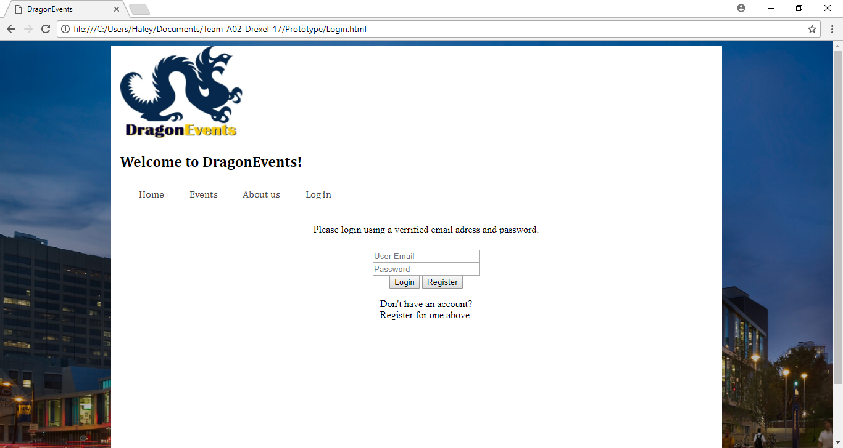
PROTOTYPE
LOGIN

Slide 4
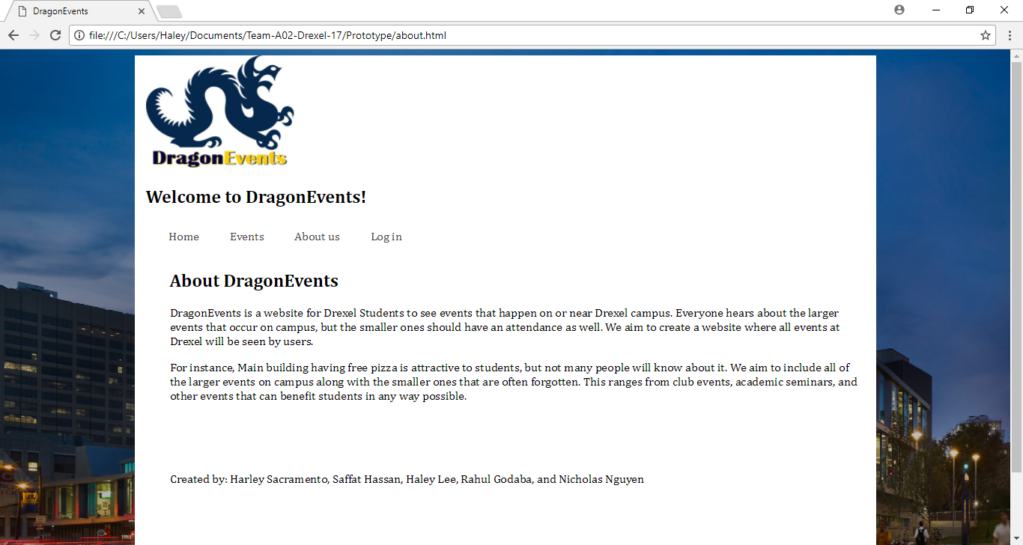
PROTOTYPE
ABOUT

Slide 5
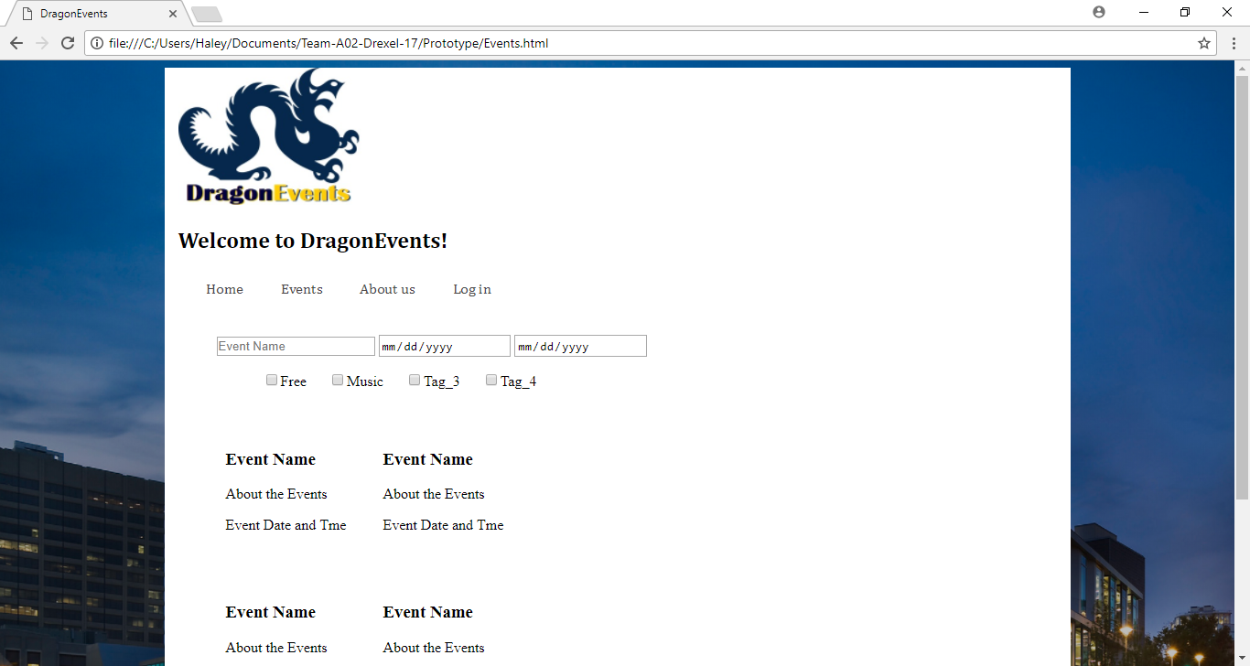
PROTOTYPE
EVENT

Slide 6
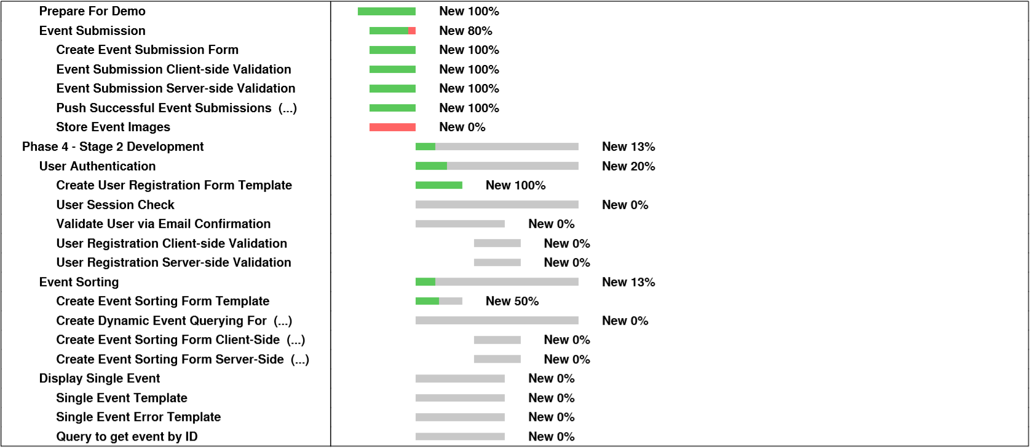
GANTT CHART

Slide 7
Scope/Task List
Completed
Submitting Events
Display Events
To-do
Displaying a specific event
User registration and login
Filtering events
Notes:
Completed
Submitting Events
Displaying Events
Todo
Displaying a specific event
User registration and login
Filtering events

Slide 8
Challenges
MySQL Setup failed on MacOS environment
Firebase is slightly different
Authentication was a much bigger challenge than previously thought
Choosing a new rendering engine
POST forms were not behaving as expected

Slide 9
DragonEvents
PROTOTYPE

